Slide 1
CrypTech
Building a More Assured
HSM Design
Randy Bush <randy@psg.com>
Notes:
A stuffed teddy bear to the person who thinks of a better name

Slide 2
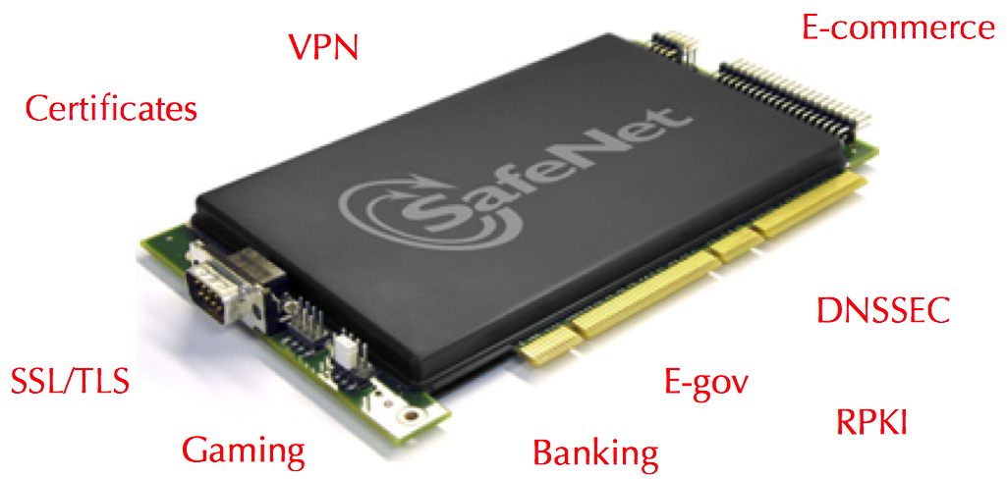
Built on the Beltway & GCHQ
Where Keys Go to Hide
A Black Box Governments Certify You Can Trust

Slide 3
Post Snowden,
No One
Trusts Them
We are relying on HSMs designed and made by 42-eyes government contractors

Slide 4
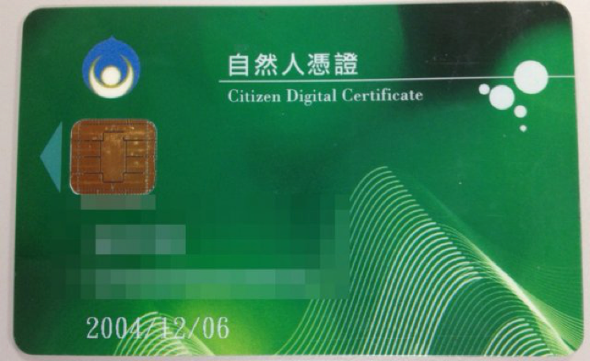
Broken Despite
Gov Issued CC Evaluation &
NIST FIPS 140-2 Validation

Slide 5
Origins
This effort was started at the suggestion of Russ Housley, Jari Arkko, and Stephen Farrell of the IETF, to meet the assurance needs of supporting IETF protocols in an open and transparent manner.
But this is NOT an IETF, ISOC, ... project, though both contribute. As the saying goes, “We work for the Internet.”

Slide 6
Goals
An open-source reference design for HSMs, not a manufactured product
Scalable, first cut in an FPGA and CPU, plan higher speed (ASIC)options later
Composable, e.g. “Give me a key store and signer suitable for DNSsec”
Reasonable assurance by being open, diverse design team, and an increasingly assured tool-chain

Slide 7
CrypTech Project
An Open Design, not a Product
Open – everything (docs, design, code)
BSD, CC license for all we develop
Diverse engineers and review
Support for transparency, testing, …
Multiple contributors: IETF, Comcast, Google, .SE, SUNET, PIR, ISOC, Afilias, RIPE, IANA, etc.

Slide 8
Layer Cake Model
Applications
DNSSEC, RPKI, PGP, VPN, OTR, random, TCP/AO, …
Off-ChipSupport Code
X.509/PGP/… Packaging, PKCS#7/10/11/15, Backup
On-Chip Core(s)
KeyGen/Store, Hash, Sign, Verify, Encrypt, Decrypt, DH, ECDH,
PKCS#1/5/8, [Un]Load, Stretching, Device Activation/Wipe
Security
Boundary
&
Tamper
Power
Timing
FPGA (ASIC)
Hashes: SHA*/GOST Encrypt: AES/Camellia PublicKey RSA/ECC/DSA, Block Crypto Modes
TRNG, BigNum, Modular, Exponentiation

Slide 9
Status Overview
State of the Art TRNG with Entropy from Avalanche & on-FPGA RingOscs
Hashes: SHA-2, SHA-256, SHA-512, SHA-512x
Stream Cipher: ChaCha
AES-128 & AES-256 (RSA Started)
BigNum and Modular Exponentiation
DNSsec Signing Summer 2015

Slide 10
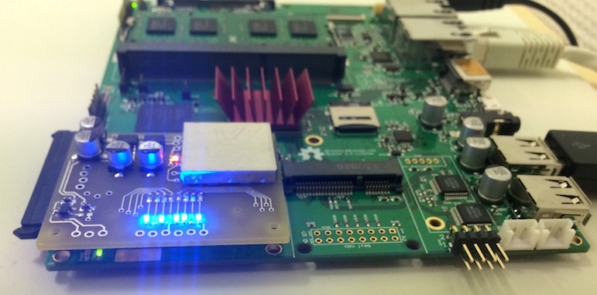
Proto on Novena Summer ‘15
FPGA

Slide 11
Alpha Board EOY 2015

Slide 12





Funding From
A Few Private Donations

